Slide 1

Donor Engagement
Presented by Kimberly Perron, MBA
Customer Success Instructor

Slide 2
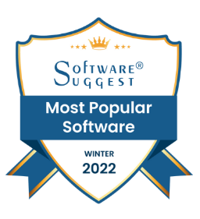




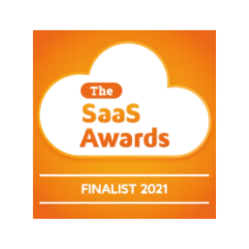
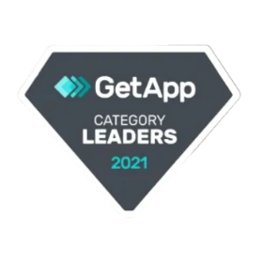
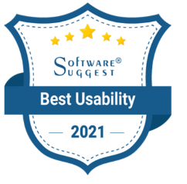


Slide 3


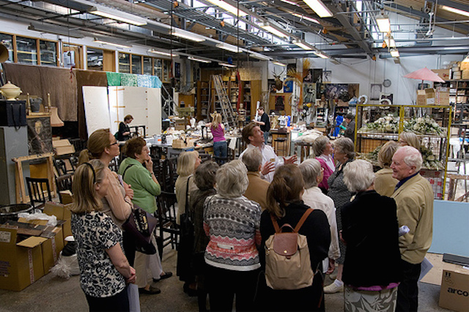
Donor Engagement

Slide 4
Donor Engagement– What is it?
Process for building relationships
Like “moves management” but more inclusive
Segments constituents to customize messaging and interactions
More than fundraising

Slide 5
Donor Engagement– Why do I need it?
Identify major gift, planned giving, volunteers, and recurring giving prospects
Create goals and strategies
Track progress
Connect to constituent’s personal mission
Validate strategies

Slide 6
POLL 1?
Does your organization have a formal donor engagement plan or moves management process?
No, we do not use any formal process.
Sort of, we have an informal process.
Yes, we have a process, but we’d are not satisfied with the results.
Yes, we have a successful process in place and we are always looking for ways to improve.

Slide 7
Donor Engagement– Annual Plan
Add details to annual plan
Schedules
Assign responsibilities
Balance resources
Define objectives
Evaluate performance

Slide 8
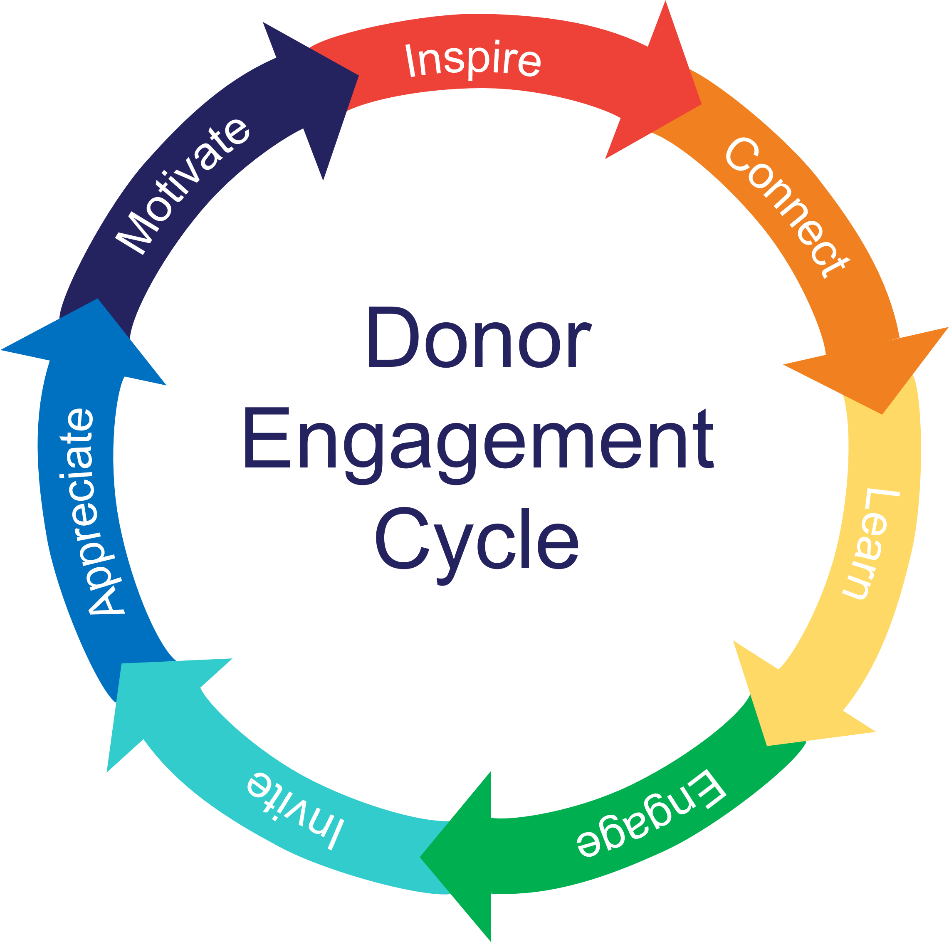
Notes:
In this session we are going to be talking about donor engagement. Donor engagement is about relationship building.
It involves all your constituents and is not just for major gifts.
It’s donor-centric – meaning it is focused on the needs of the donor, not the needs of the organization.
The elements of the cycle can happen concurrently, out of sequence, and repeat.

Slide 9
Inspire
Inspire
Motivate
Connect
Donor
Engagement
Cycle
Appreciate
Learn
Invite
Engage
Notes:
The elements include:
Inspire – create awareness of your organization and cause with your marketing strategy.

Slide 10
Inspire
Connect
Motivate
Donor
Engagement
Cycle
Appreciate
Learn
Invite
Engage
Notes:
Connect – provide opportunities for constituents to learn more about your organization, dipping their toes in the water.

Slide 11
Inspire
Learn
Motivate
Connect
Donor
Engagement
Cycle
Appreciate
Invite
Engage
Notes:
Learn – how you can learn more about the constituent
i. What is important to them?
ii. Why are they interested in your cause?
iii. What impact do they want to make?

Slide 12
Inspire
Engage
Motivate
Connect
Donor
Engagement
Cycle
Appreciate
Learn
Invite
Notes:
Engage – Based on the constituent’s interest, how can they make a larger impact

Slide 13
Inspire
Motivate
Invite
Connect
Donor
Engagement
Cycle
Appreciate
Learn
Engage
Notes:
Invite – Create proposals that support your donor’s personal mission

Slide 14
Inspire
Appreciate
Motivate
Connect
Donor
Engagement
Cycle
Learn
Invite
Engage
Notes:
Appreciate – Thank your donors, recognize their support, and steward their gift

Slide 15
Inspire
Motivate
Connect
Donor
Engagement
Cycle
Appreciate
Learn
Invite
Engage
Notes:
Motivate – Inspiring the constituent to deepen their commitment, even making the ultimate legacy gift.

Slide 16
Inspire
Connect
Learn
Engage
Invite
Appreciate
Motivate
Marketing
Social Media
Articles
Press
Website
Outreach
Videos
Referrals
Partnerships
Join newsletter
Event Pages
Donation Pages
Volunteer
P2P
Welcome packages (first timers)
Virtual events
Text 2 Give
Auctions
Surveys
Link Clicks
Categories & Multi-select fields
Interactions
Relationships
Time tracking
Portal updates
Newsletter guest writer
Volunteer trainers, P2P Team Leaders
Share experience (private events)
Insider info (email lists)
Clubs (categories)
Recurring gifts
Pledges
Custom proposals
Planned interactions
Prompt acknow-ledgments (mail merge)
Newsletters & Annual Reports (reports)
Physical recognition –Naming
Special appreciation events
Leadership – Board of Directors, Event Hosts, Campaign Chairs
Advocacy societies (automatic actions)
Legacy gifts (pledges, categories, & interactions)
Notes:
Now we can break out all the elements of the Donor Engagement Cycle and review the activities.

Slide 17
Inspire
Inspire
Motivate
Connect
Donor
Engagement
Cycle
Appreciate
Learn
Invite
Engage
Notes:
The elements include:
Inspire – create awareness of your organization and cause with your marketing strategy.

Slide 18
POLL 2?
Does your organization have a communications or marketing plan?
No, we don’t have a plan.
Sort of, we do marketing, but it is not scheduled or planned.
Yes, we have a plan in place, but have a tough time managing it.
Yes, we have a formal plan in place and have good results.

Slide 19
Inspire – Creating Awareness
Marketing activities & materials
Website
Outreach presentations
Partnerships
Referrals
Social media
PR

Slide 20
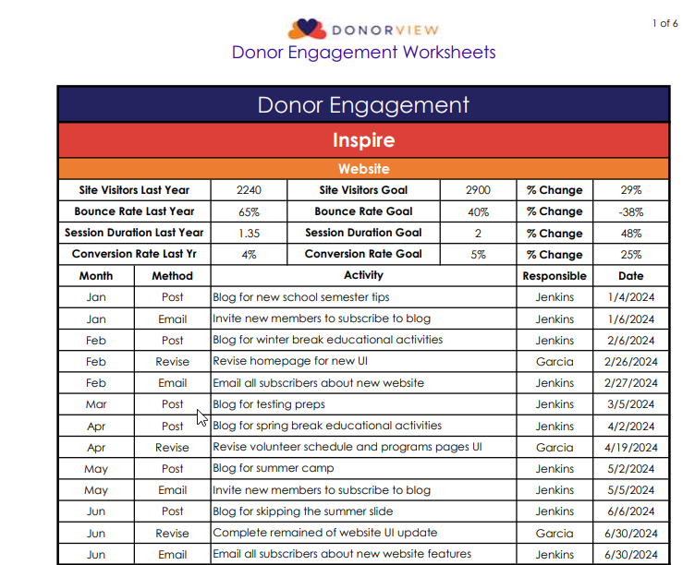

Slide 21
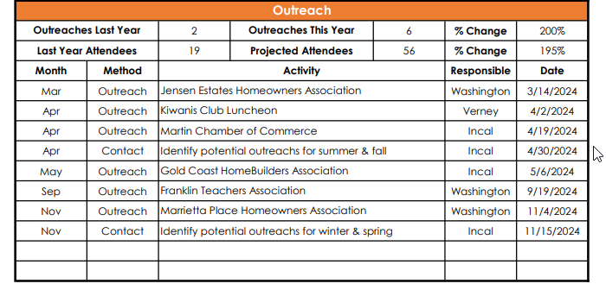

Slide 22
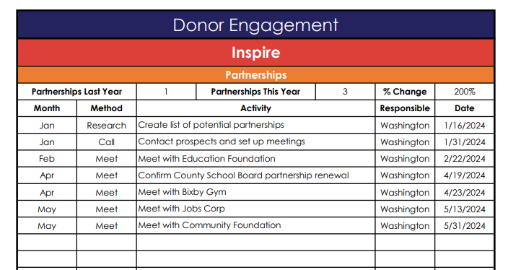

Slide 23
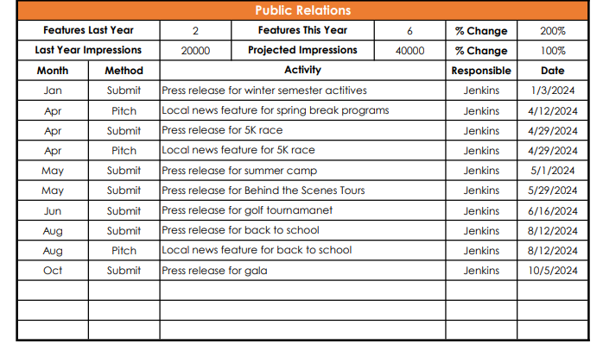

Slide 24
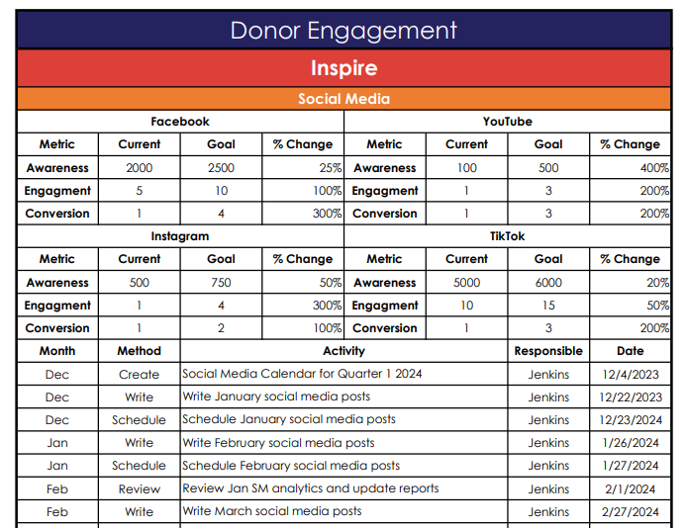

Slide 25
Inspire
Connect
Motivate
Donor
Engagement
Cycle
Appreciate
Learn
Invite
Engage
Notes:
Connect – provide opportunities for constituents to learn more about your organization, dipping their toes in the water.

Slide 26
Connect – Easy entry points
Make it easy to connect
Good first impression
Make a small donation, purchase event tickets or join membership
See & sign up for volunteer opportunities
Text-2-Give or QR Codes
Welcome packages

Slide 27
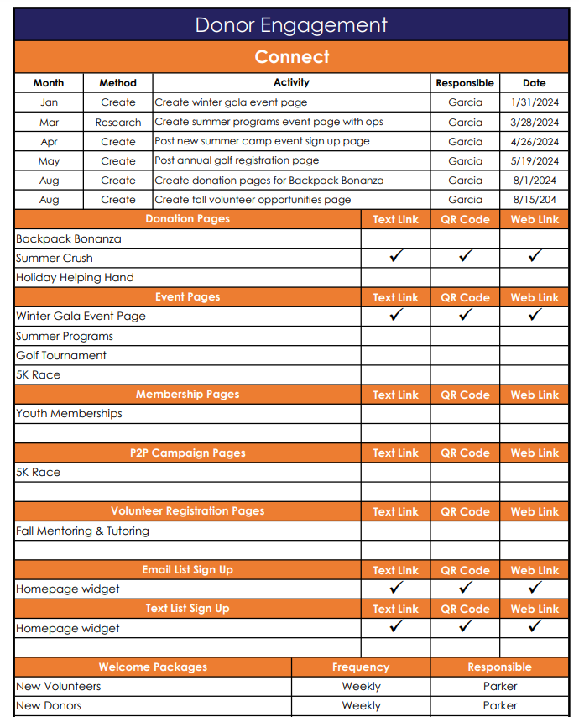

Slide 29
Inspire
Learn
Motivate
Connect
Donor
Engagement
Cycle
Appreciate
Invite
Engage
Notes:
Learn – how you can learn more about the constituent
i. What is important to them?
ii. Why are they interested in your cause?
iii. What impact do they want to make?

Slide 30
Learn – Get to know them
Determine their personal mission
Use surveys
Add to categories or groups
Preferred communication methods
Relationships
Volunteer activities
Research

Slide 31
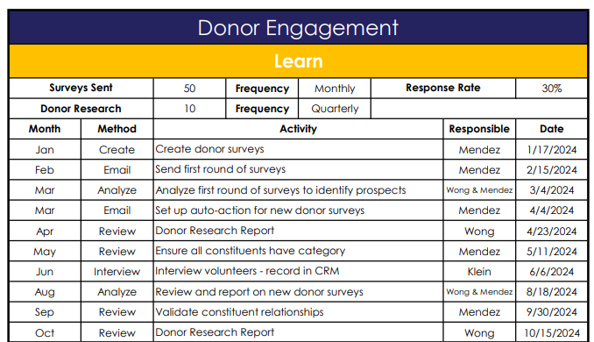

Slide 32
Inspire
Engage
Motivate
Connect
Donor
Engagement
Cycle
Appreciate
Learn
Invite
Notes:
Engage – Based on the constituent’s interest, how can they make a larger impact

Slide 33
Engage – Level Up
Guest writers
Peer-2-Peer team leader
Volunteer trainer
Host a private event
Behind the scenes tours
Donor cocktail parties
Clubs and societies

Slide 34
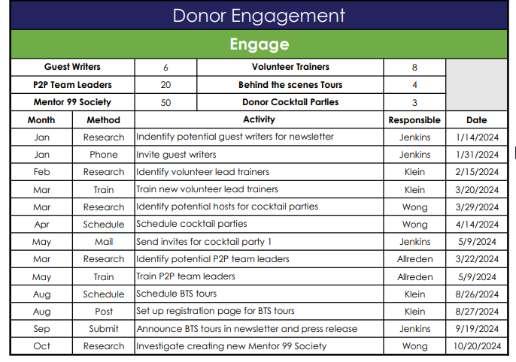

Slide 35
Inspire
Motivate
Invite
Connect
Donor
Engagement
Cycle
Appreciate
Learn
Engage
Notes:
Invite – Create proposals that support your donor’s personal mission

Slide 36
POLL 3?
Does your organization accept pledges or recurring donations?
No, it’s not on our radar at this time.
No, but we’d like to start.
Yes, but we don’t promote it.
Yes, we receive pledges and recurring donations.

Slide 37
Invite – Meaningful gifts
Upgrade to recurring gifts
Special appeals for specific projects
Multi-year pledges
Custom proposals for major gifts
Utilize CRM to research, plan and track

Slide 38
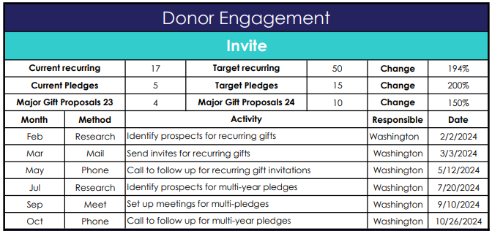

Slide 39
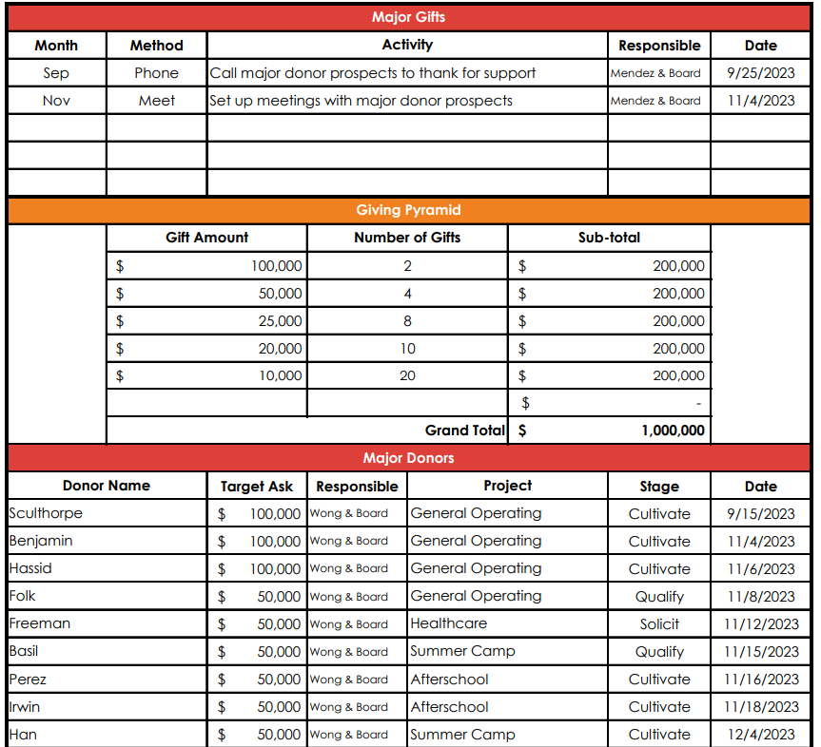

Slide 40
Inspire
Appreciate
Motivate
Connect
Donor
Engagement
Cycle
Learn
Invite
Engage
Notes:
Appreciate – Thank your donors, recognize their support, and steward their gift

Slide 41
Appreciate – Attitude of gratitude
Personal and immediate thank you’s
Physical naming opportunities
Appreciation events
Special deliveries
Gift stewardship
Reports
Meetings
Newsletter impact reports

Slide 42
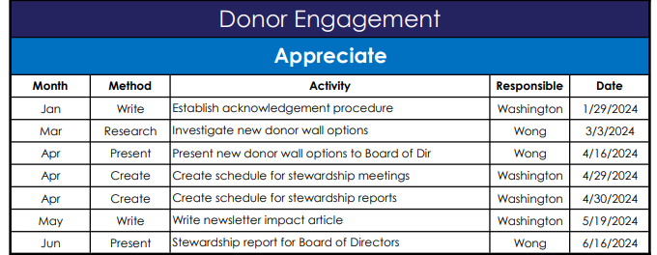

Slide 43
Inspire
Motivate
Connect
Donor
Engagement
Cycle
Appreciate
Learn
Invite
Engage
Notes:
Motivate – Inspiring the constituent to deepen their commitment, even making the ultimate legacy gift.

Slide 44
Motivate – Their life’s mission
Leadership opportunities
Board of Directors
Event Hosts
Campaign Chairs
Advocacy
Speakers
Visiting politicians
Planned giving

Slide 45
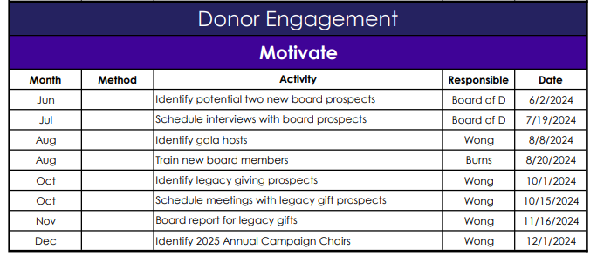

Slide 46
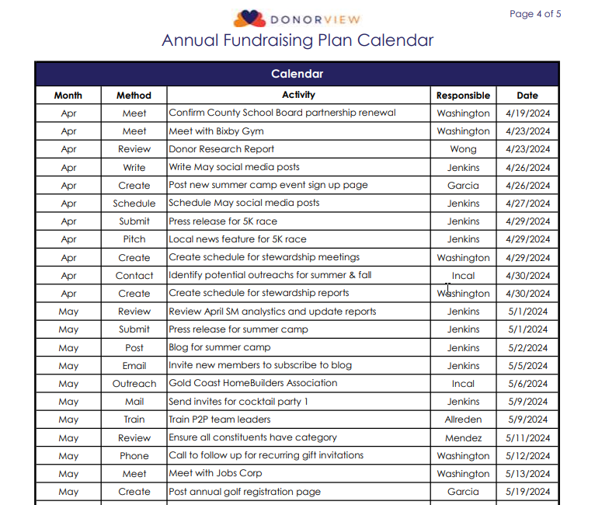
Donor Engagement– Calendar

Slide 47
Notes:
There is a lot to donor engagement – lots of activities, lots of things to track, lots of analysis required to make it effective. So today I want to show you how to use the power of your CRM to help you implement this.

Slide 48
Inspire
Connect
Learn
Engage
Invite
Appreciate
Motivate
Marketing
Social Media
Articles
Press
Website
Outreach
Videos
Referrals
Partnerships
Join newsletter
Event Pages
Donation Pages
Volunteer
P2P
Welcome packages (first timers)
Virtual events
Text 2 Give
Auctions
Surveys
Link Clicks
Categories & Multi-select fields
Interactions
Relationships
Time tracking
Portal updates
Newsletter guest writer
Volunteer trainers, P2P Team Leaders
Share experience (private events)
Insider info (email lists)
Clubs (categories)
Recurring gifts
Pledges
Custom proposals
Planned interactions
Prompt acknow-ledgments (mail merge)
Newsletters & Annual Reports (reports)
Physical recognition –Naming
Special appreciation events
Leadership – Board of Directors, Event Hosts, Campaign Chairs
Advocacy societies (automatic actions)
Legacy gifts (pledges, categories, & interactions)
Notes:
While you are creating or updating your plan, be sure to include those actions you will be using in your CRM and assign the responsible person to accomplish those activities.

Slide 49
Download the free Fundraising Plan Excel worksheets Donorview.com/AFPwebinar
Next Steps
Register at AFP Global for next webinars
December 6th - “Measuring and Evaluating the Results of your Fundraising Strategy and Plan with KPIs”

Slide 50
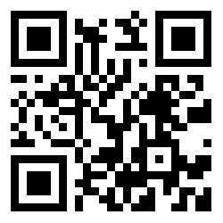
THANK YOU!
Request a Demo
Scan to visit our website and set up a free demo!
DonorView.com/Demo
Contact Us:
508-205-0243
sales@donorview.com
donorview.com

Slide 51
Questions?

